Slide 1
Q-It
Presenters:
Najma Mohamed, Scott Vlasic, Brennen Hogan, Megan Rousslang, Saahil Chadha

Slide 2
Agenda
1
Problem
2
Idea Overview
3
User Story
4
The Five Ws
5
Demo

Slide 3
Problem
Member opportunities for a faster check-Ins are impacting member experience.
Wait times can be as long as an hour or more.
Get patient information before their scheduled appointments.
Reduce the waiting time as well as prepare the doctor to do all it’s initial search of information to diagnosing the issue in a timely manner.
.
Notes:
at our hospitals and urgent cares where our consumers are in and out fully satisfied with the care. However, consumer arrival rate is faster than live check-ins.
. As a result, patients waste approximately two hours or more overall between waiting, getting checked in, and receiving the care they came for.
Prioritize time efficiency by letting our get what they came for in timeless manner. To do this, we need to

Slide 4
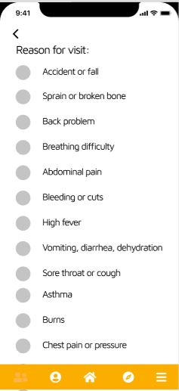
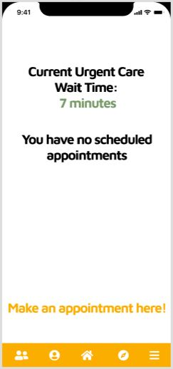
Idea Overview
A queuing application where members are notified of the current wait-time before arriving to the hospital,
Confidently meet UHC’s opportunity to answer, “Did your doctor see you within 15 minutes of your scheduled appointment?” as “Always”
Notes:
as a result, this will also help open up for patients with more critical needs to get faster assistence.

Slide 5
Case #1:
USER STORY
Summer Houston

Slide 6
The Five Ws
Who will:
Providers
All Directors, CM and CC where UHC support CnS will benefit from this application
What:
Check
WaitWhile and waitlist both have queuing application.
When:
Available 24/7 for members to connect and request
Where
Will be delivered via web/phone app
Why:
Designed for UHC to work with its providers to improve responses for UHC patients.

Slide 7
DEMO

